Slide 1
COMP6115 Object Oriented Analysis and Design Session #5

Slide 2
Structural Modeling

Slide 3
Learning Outcomes
LO1: Identify the basic concept of advance topic in Object Oriented Analysis and Design
LO2 : Use the knowledge to develop documentation for object oriented software analysis and design using Unified Modelling Language
LO3 : Analyze any problem in any software application and find out the alternative solutions using object oriented analysis and design approach

Slide 4
Chapter 5: Structural Modeling

Slide 5
Objectives
Understand the rules and style guidelines for creating CRC cards, class diagrams, and object diagrams.
Understand the processes used to create CRC cards, class diagrams, and object diagrams.
Be able to create CRC cards, class diagrams, and object diagrams.
Understand the relationship among structural models.
Understand the relationship between structural and functional models.

Slide 6
Introduction
Functional models represent system behavior
Structural models represent system objects and their relationships:
People
Places
Things

Slide 7
Structural Models
Drawn using an iterative process
First drawn in a conceptual, business-centric way
Then refined in a technology-centric way describing the actual databases and files
More and more detail is added in each iteration
Create a vocabulary for analysts & users
Allows effective communication between analysts & users

Slide 8

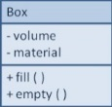
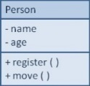
Structural Models
Main goal: to discover the key data contained in the problem domain and to build a structural model of the objects
Structural
Modeling
Problem Domain
Solution Domain

Slide 9
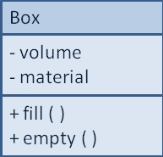
Classes, Attributes, & Operations
Classes:
Templates for instances of people, places, or things
Attributes:
Properties that describe the state of an instance of a class (an object)
Operations:
Actions or functions that a class can perform

Slide 10
Relationships
Describe how classes relate to one another
Three basic types in UML
Generalization
Enables inheritance of attributes and operations
Represents relationships that are “a-kind-of”
Aggregation
Relates parts to wholes or assemblies
Represents relationships that are “a-part-of” or “has-parts”
Association
Miscellaneous relationships between classes
Usually a weaker form of aggregation

Slide 11
Object Identification
Textual analysis of use-case information
Nouns suggest classes
Verbs suggest operations
Creates a rough first cut to provide an object list
Brainstorming—people offering ideas
Initial list of classes (objects) is developed
Attributes, operations and relationships to other classes can be assigned in a second round

Slide 12
Object Identification (cont.)
Common Object Lists
Physical things
Incidents
Roles
Interactions
Patterns
Useful groupings of collaborating classes that provide solutions to common problems (are reusable)
Developed patterns provide a starting point for work in similar domains

Slide 13
CRC Cards
Index cards used to document the responsibilities and collaborations of a class
Responsibilities
Knowing—what a class must know manifested as attributes
Doing—what a class must do manifested later as operations
Collaboration
Objects working together to service a request:
Requestor (client)
Responder (server)
Bound by a contract

Slide 14
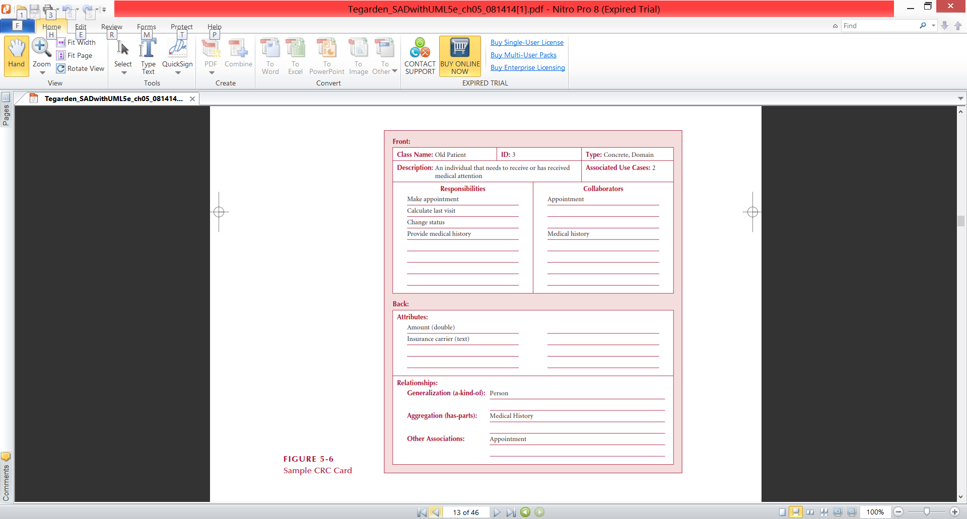
Front-Side of a CRC Card

Slide 15
Back-Side of a CRC Card

Slide 16
CRC Cards & Role-Playing
An exercise to help discover additional objects, attributes, relationships & operations
Team members perform roles associated with the actors and objects previously identified
Utilize activity diagrams to run through the steps in a scenario
Identify an important use-case
Assign roles based on actors and objects
Team members perform each step in the scenario
Discover and fix problems until a successful conclusion is reached
Repeat for remaining use-cases

Slide 17
Class Diagrams
A static model that shows classes and their relationships to one another
Elements
Classes
Objects within the system (a person, place or thing)
Stores and manages information in the system and contains:
Attributes—characteristics of the class
Operations—activities the class can perform
Relationships—the associations between classes
Depicted as lines between classes
Multiplicity indicates how many of one object is/are associated with other objects

Slide 18
Attributes
Properties of a class
Person: last name, first name, address, etc.
Attributes can be derived
Preceded with a slash (/)
e.g., age is derived from date of birth
Visibility of an attribute:
Restricts access to attributes to ensure consistency
Public attributes (+): visible to all classes
Private attributes (-): visible only to an instance of the class in which they are defined
Protected attributes (#): visible only to an instance of the class in which they are defined and its descendants

Slide 19
Operations
Common operations are not shown
Create or delete an instance
Return or set a value
Types of operations:
Constructor—creates an object
Query—makes information about the state of an object available
Update—changes values of some or all of an object’s attributes
Destructor—deletes or removes an object

Slide 20
Relationships
Denotes associations between classes
Depicted with a line labeled with the name of the relationship
May be directional (depicted with a triangle; e.g., a patient schedules an appointment)
Classes may be related to themselves (e.g., employees and managers who may be members of the same class)
Multiplicity indicates how many of one class are related to another class

Slide 21
Multiplicities
Exactly one:
A department has one and only one boss
Department
Boss
1
1
Zero or more:
An employee has zero to many children
Employee
Child
1
0..*
One or more:
A boss is responsible for one or more employees
Boss
Employee
1
1..*

Slide 22
Association Classes
Common in many-to-many relationships
Used when attributes about the relationship between two classes needs to be recorded
Students are related to courses; a Grade class provides an attribute to describe this relationship
Illnesses are related to symptoms; a Treatment class provides an attribute to describe this relationship

Slide 23
Generalization & Aggregation Associations
Generalization denotes inheritance
Properties and operations of the superclass are valid for the sub-class
Depicted as a solid line with a hollow arrow pointing at the superclass
Aggregation denotes a logical “a-part-of” relationship
Composition denotes a physical “a-part-of” relationship

Slide 24
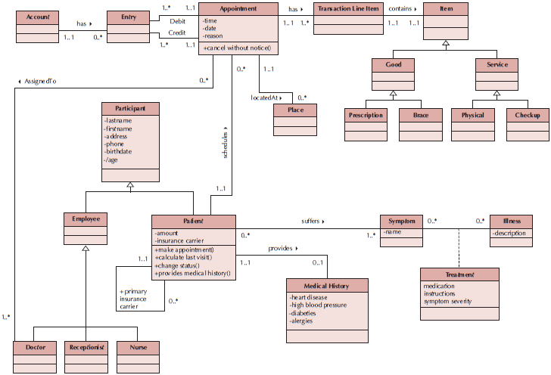
Sample Class Diagram

Slide 25
Simplifying Class Diagrams
Fully populated class diagrams of real-world system can be difficult to understand
Common ways of simplifying class diagrams:
Show only concrete classes
The view mechanism shows a subset of classes
Packages show aggregations of classes (or any elements in UML)

Slide 26
Object Diagrams
Class diagrams with instantiated classes
Example: instead of a Doctor class, create an actual doctor, say Dr. Smith
Place values into each attribute
Used to discover additional attributes, relationships and/or operations or those that are misplaced

Slide 27
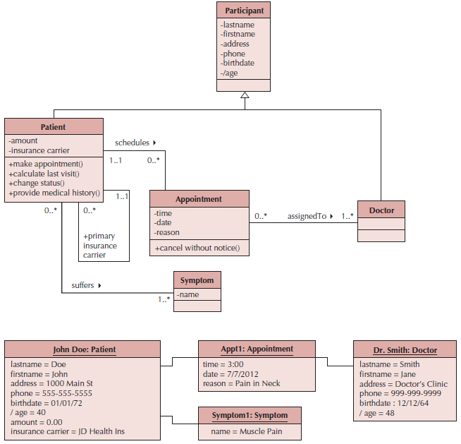
Example Object Diagram

Slide 28
7 Steps to Structural Models
Create CRC Cards
Review CRC Cards & identify missing objects, attributes, operations and/or relationships
Role-play the CRC cards—look for breakdowns & correct; create new cards as necessary
Create the class diagram
Review the class diagram—remove unnecessary classes, attributes, operations and/or relationships
Incorporate patterns
Review and validate the model

Slide 29
Verifying & Validating the Model
Analyst presents to developers & users
Walks through the model
Provides explanations & reasoning behind each class
Rules
Each CRC card is associated with a class
Responsibilities on the front of the card are included as operations on the class diagram
Collaborators on the front of the card imply a relationship on the back of the card
Attributes on the back of the card are listed as attributes on the class diagram

Slide 30
Rules for Validating & Verifying the Model (cont.)
Attributes on the back of the CRC card each have a data type (e.g., salary implies a number format)
Relationships on the back of the card must be properly depicted on the class diagram
Aggregation/Association
Multiplicity
Association classes are used only to include attributes that describe a relationship

Slide 31
Summary
Structural Models
CRC Cards
Class Diagrams
Creating CRC Cards and Class Diagrams

Slide 32
References
Denis, Wixom,Tegarden. (2015). Systems Analysis and Design: An Object-Oriented Approach with UML. 5th edition. ISBN: 978-1-118-80467-4, John Wiley & Sons, Inc, Denver (USA)

